Slide 1


Chapter 3. System Programming Concepts
Linux
December 27, 2018
Jeyeon Lee & Sangmin Lee
Dept. of Software
Dankook University
2reenact@naver.com
dltkd96als@naver.com

Slide 2
Chapter Objectives
Understand the steps when occurring system calls
The difference between system calls & library functions
How to check the return status
Look at the example programs in this book
command-line options and arguments
common functions and header files
Diverse portability issues

Slide 3
System Calls (1/2)
What is System Call?
Controlled entry point into the kernel
Allowing a process to request the kernel perform some action
The kernel makes a range of services via the system call API
Creating a new process
Performing I/O
Creating a pipe for IPC
Change the processor state to kernel mode
CPU can access protected kernel memory
Each system call is identified by a fixed unique number.
Has a set of arguments to be transferred from user space

Slide 4
System Calls (2/2)
What is System Call?
Steps when they occur on a Hardware (x86-32)
The program makes a system call by invoking a wrapper function
Since System call trap-handling routine expects arguments in specific registers. they are copied to specific registers
System call number is copied into a specific CPU register
The wrapper function executes a trap machine instruction
The kernel invokes its system_call() routine
Saves register values onto the kernel stack
Checks the validity of the system call number
Invoke the appropriate system call service routine
Restore register value
Return to wrapper function and user mode

Slide 5
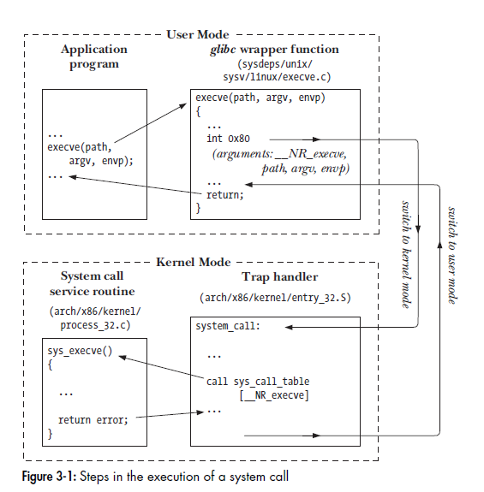
System Calls (2/2)
What is System Call?
Steps when they occur on a Hardware (x86-32)
The program makes a system call by invoking a wrapper function
Since System call trap-handling routine expects arguments in specific registers. they are copied to specific registers
System call number is copied into a specific CPU register
The wrapper function executes a trap machine instruction
The kernel invokes its system_call() routine
Saves register values onto the kernel stack
Checks the validity of the system call number
Invoke the appropriate system call service routine
Restore register value
Return to wrapper function and user mode

Slide 6
Libraries (1/2)
Library Functions
is simply one of the multitude of functions
Allowing a process to request the kernel perform some action
The kernel makes a range of services via the system call API
Creating a new process
Performing I/O
Creating a pipe for IPC
There are very diverse purposes of functions
Which don’t make any use of system calls
String manipulation functions
Converting time to readable format
Layered on top of system calls
Opening files
Memory allocation

Slide 7

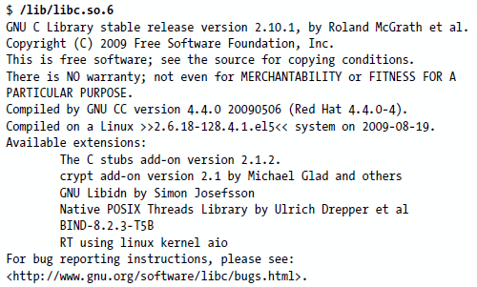
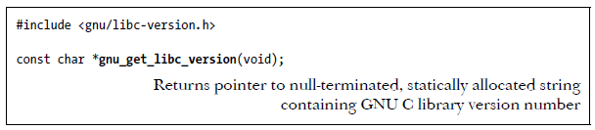
Libraries (2/2)
The GNU C Library (glibc)
The most commonly used implementation on Linux
The way to determining version of glibc
On shell
Run the glibc file as it were an executable program
Execute the ldd program against an executable linked dynamically against glibc
In program
Testing constants ( _GLIBC_ and _GLIBC_MINOR_ )
Calling a library function

Slide 8
Handling Errors (1/3)
System Call Errors
Usually, an error is indicated by a return of -1
Sets the global integer variable errno to a positive value
Value identifies the specific error
Including <errno.h> provides a declaration of errno
As a set of constants for the various error numbers
These symbolic names commence with E
Commonly, print an error message based on the errno value
The perror() and strerror() library functions are provided for this purpose

Slide 9
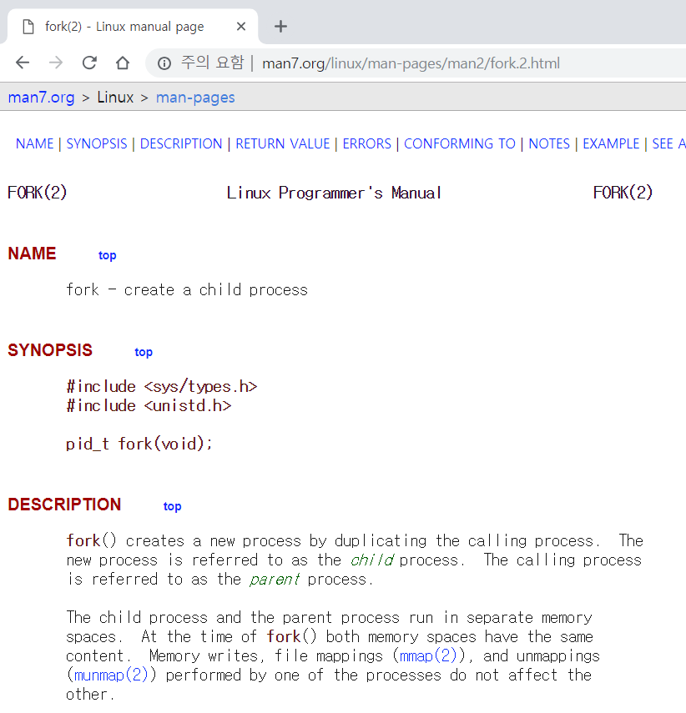
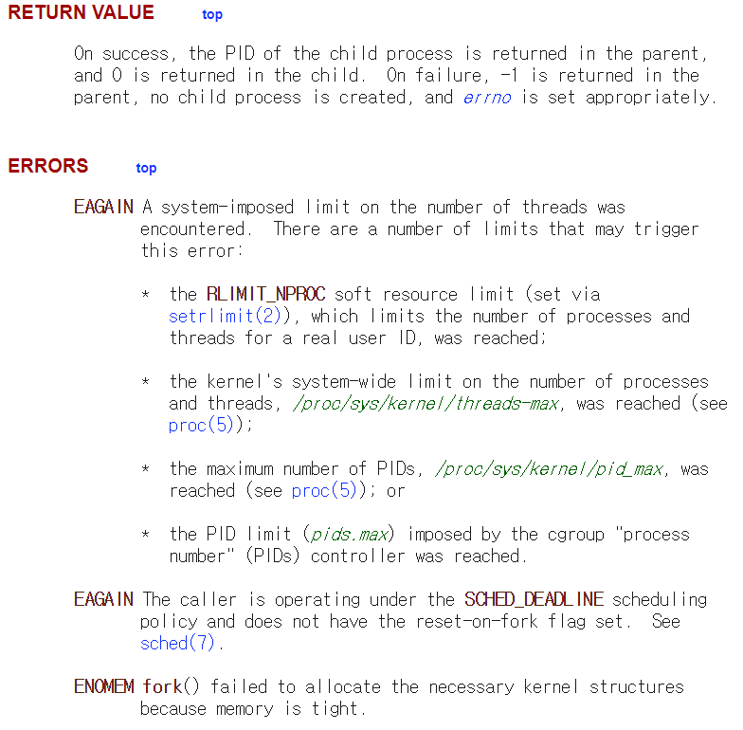
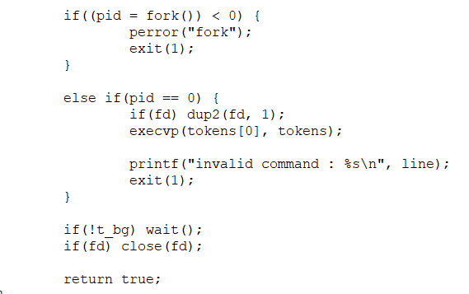
Handling Errors (2/3)
System Call Error Handling Example

Slide 10
Handling Errors (3/3)
Library Function Errors
There is 3 categories
Return error information in exactly the same way as system calls
-1 return value
Indicated by the specific errno
Set errno to specific error condition but not return -1
don’t use errno or return value at all
Need to use appropriate method to functions in this case

Slide 11
Example program (1/4)
Command-line options & arguments
Traditional UNIX command-line options
Initial hyphen(-) + a letter(identify the option) + argument(optional)
GNU utility(extended option syntax)
two initial hyphen(--) + a string(identify the option) + argument(optional)

Slide 12
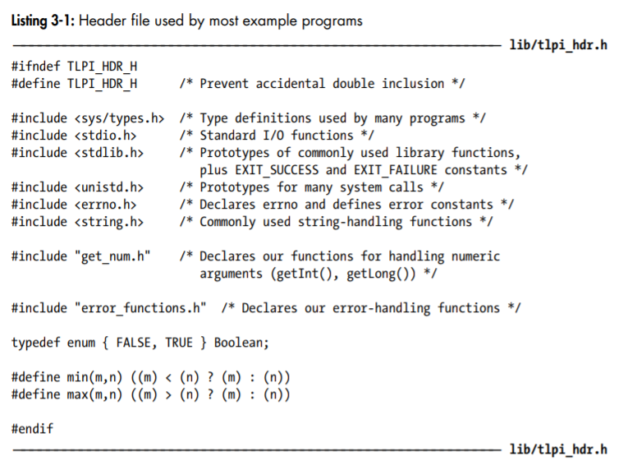
Example program (2/4)
Common functions & header files
Common header files

Slide 13
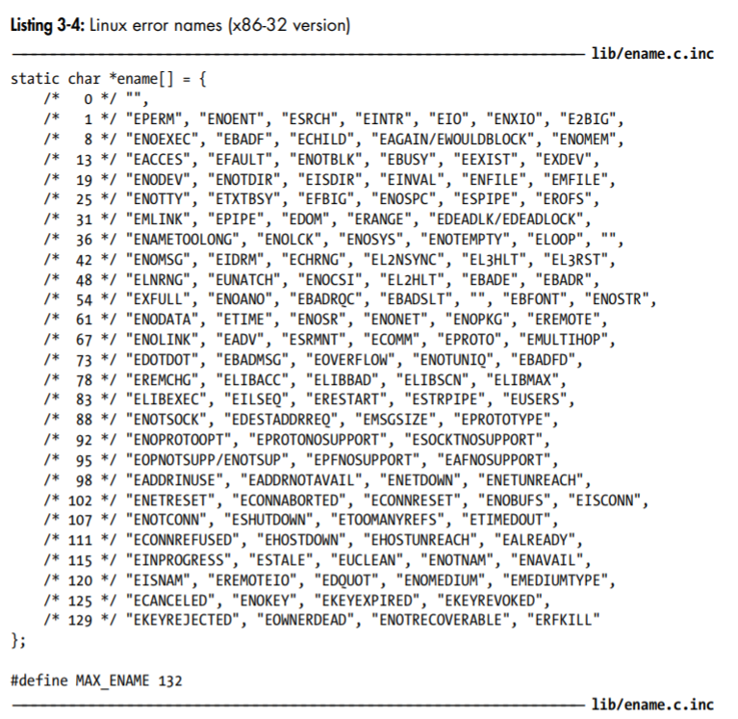
Example program (3/4)
Common functions & header files
Error-diagnostic functions
errMsg() : Print a message on standard error
errExit() : Terminate the program by calling exit()
err_exit() : It doesn’t flush standard output before printing the error message
Terminate the program by calling _exit()
errExitEN() : Print the text corresponding to the error number given in the argument errnum
fatal() : It is used to diagnose general errors, including errors from library functions that don’t set errno
usageErr() : Print the string Usage: followed by the formatted standard error
Terminate the program by calling exit()
cmdLineErr() : It is used to diagnose errors in the command-line arguments specified to a program

Slide 14
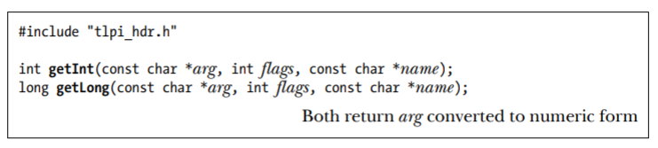
Example program (4/4)
Common functions & header files
Functions for parsing numeric command-line arguments
Advantage
Provide some basic validity checking of numeric arguments
Example
getInt(), getLong() : Convert the string pointed to by arg to an int or a long
name : Contain a string identifying the argument in arg (if non-NULL)
flags : Provide some control over the operation of the getInt() and getLong()

Slide 15
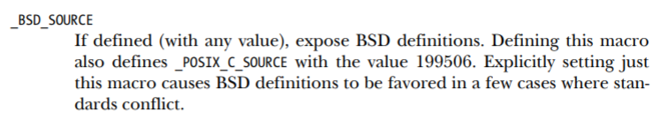
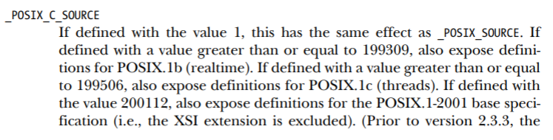
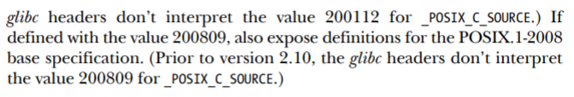
Portability issues (1/5)
Feature Test Macros
Various standards govern the behavior of the system call and library funtion APIs
Define the macro before including any header files(#include)
-> #define _BSD_SOURCE 1
Use the –D option to the C compiler
-> $ cc –D _BSD_SOURCE prog.c

Slide 16
Portability issues (2/5)
System data types
Various implementation data types(process IDs, user IDs, and file offsets) are represented using standard C types
C types such as int and long, reduce portability across UNIX system
The size of these fundamental types vary across UNIX implementations, or even in different compilation environments on the same implementation
Even on a single UNIX implementation, the types used to represent information may differ between releases(version) of the implementation
Standard system data types (by SUSv3)
It is defined using the C typedef feature
-> typedef int pid_t;
Most of these data types have names ending in _t
-> pid_t mypid;

Slide 17
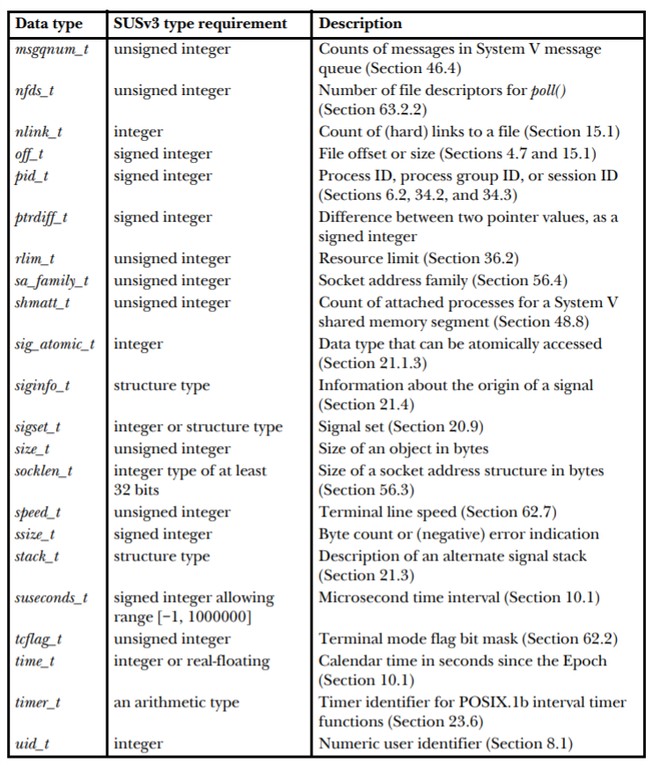
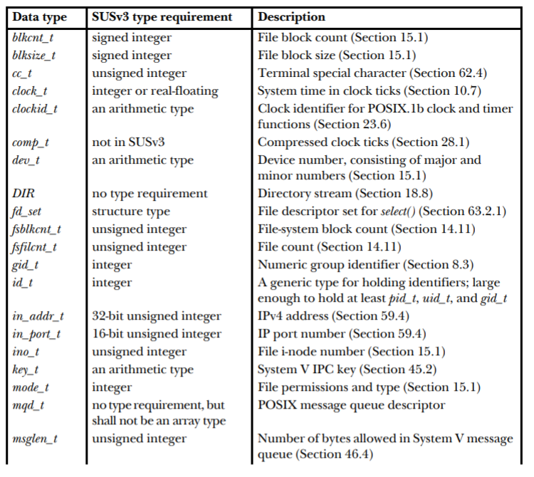
Portability issues (3/5)
System data types

Slide 18

Portability issues (4/5)
System data types
Printing system data type values
When printing values of one of the numeric system data types(pid_t and uid_t)
be careful not to include a representation dependency in the printf() call
use the %ld specifier and cast the corresponding value to long

Slide 19
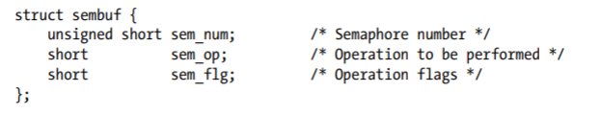
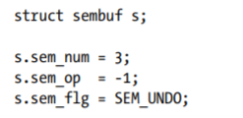
Portability issues (5/5)
Miscellaneous portability issues
Initializing and using structures
the order of field definitions within such structures is not specified
extra implementation-specific fields may be included
Portable initializing
Use explicit assignment statement

Slide 20
Thank you
Linux

